Slide 1
Modernize your monolith in a cloud-native fashion
Notes:
This is a starter slide. You do not have to say anything related to the text on the screen. It must be displayed on the screen as intro, when people come to the presentation, they sit and relax and this initial sentence already introduces them into the subject.

Slide 2
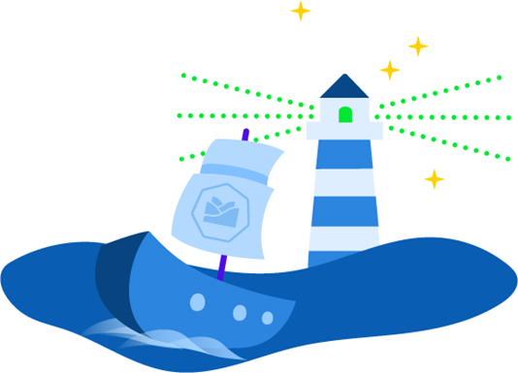
What is Kyma?
Kyma is an open source project
designed natively on Kubernetes.
Notes:
First make it super clear to the audience what Kyma actually is. Set clear expectations, it is for free and only for Kubernetes users. So on one side it is pretty limited to specific PaaS but on the other hand it is free.

Slide 3

What does Kyma mean?
Kyma (κύμα), pronounced as / kee-ma /, is a Greek word meaning “wave”, as in wave of the sea.
Click the icon to hear how to pronounce Kyma
Notes:
Make it clear what Kyma is. Pronunciation is one thing, meaning is the other. Kyma is a cozy wave on which you take you Kubernetes journey.

Slide 4
Challenges
Too many systems
Fragmented infrastructure consisting of
various products from different vendors
that require a different skillset to develop.
Too much risks
Difficult to incorporate innovation
scenarios based on iterative
“test & learn” approach into
existing infrastructure.
Slow
Hard to develop with strong
dependency to monolith release cycles.
Hard access
Fast access to managed services
from cloud providers is crucial.
Consumption is not that easy.
Monoliths are getting too big
Large applications are difficult
to customize or have complicated
upgrade paths as a result.
Cloud-native is not that easy
For building applications following a
cloud-native approach to leverage all
cloud benefits a different skillset is needed.
Notes:
Purpose of this slide is to introduce audience to Kyma through identification with challenges they might have and that can be solved with Kyma.
When you start this slide, remember to make it clear to the audience that if there is at least one challenge they identify with, they should look into Kyma.
This slide shows each challenge one by one, but still it might be to much content for the audience. If you feel experienced enough to transform this slide into 6 separate slides with pictures only that visualize the headline, and you can explain it with your own words...do it.
Too many systems – there are many companies that have to integrate many products together and do it individually in each product, while Kyma make it possible to do it in just one place.
Too much risks – due to complexity of the infrastructure companies tend to avoid quick iterative innovations that can be quickly introduced and taken off in case of no success. With Kyma you can quickly prototype and introduce changes.
Slow – due to complexity of legacy system and its long release cycles you are getting slow with new functionalities. Kyma assures you are not dependent on any releases, you can introduce any extensions with individual release cycles
Hard access – in large organizations you tend to have big teams that manage access to cloud services that are the gate keepers to the system. It is a long run to get access to cloud providers, additional processes that you want to avoid. Kyma with support of service catalog can integrate services from various different cloud providers.
Monoliths are getting too big – introducing even small changes in monolith takes time and complicated setup. Onboarding to the solution is also time consuming and complicated. Kyma takes this this away because of easiness to write microservices, functions or mashups of different APIs with all the needed tools integrated
Cloud-native is not that easy – you can start cloud native without Kyma, sure, but make it clear that it is not an easy task. You have there all the different tools, open source, for monitoring, for tracing, for logging, but there is not single solutions that seamlesly integrates them all in one solution

Slide 5
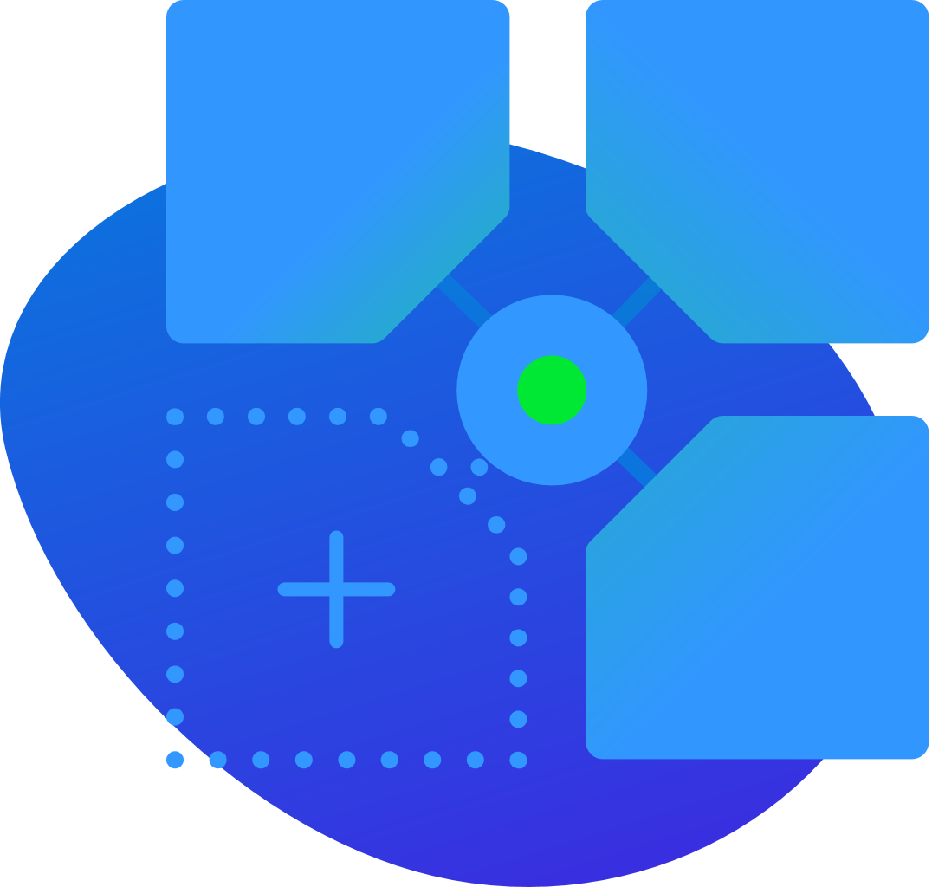
Kyma benefits
Consume services from any source, seamlessly connect, and use the technology and
language of your choice.
Notes:
Here you make a connection to challenges. How Kyma addresses those challenges? what are the benefits of using Kyma?

Slide 6
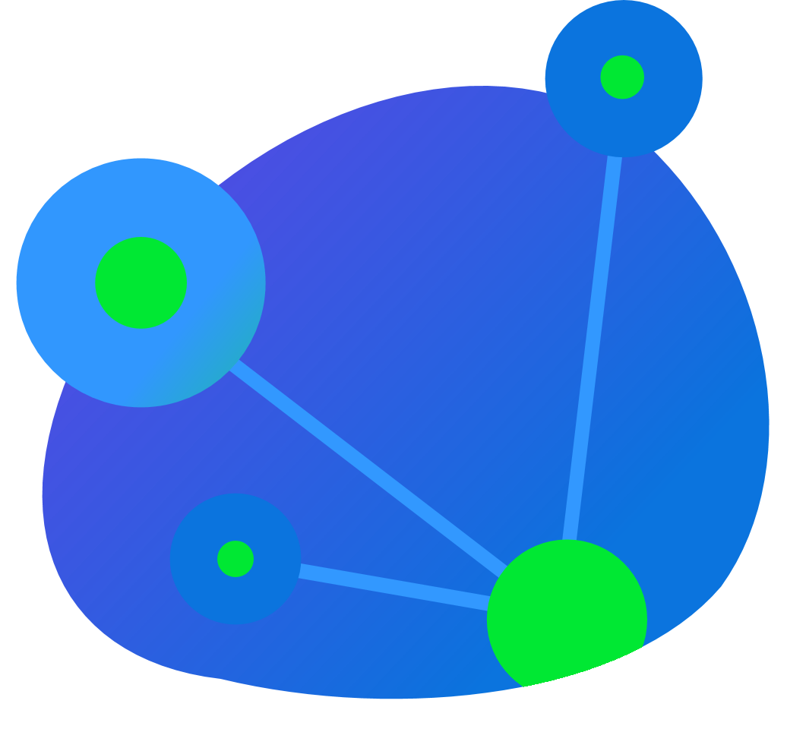
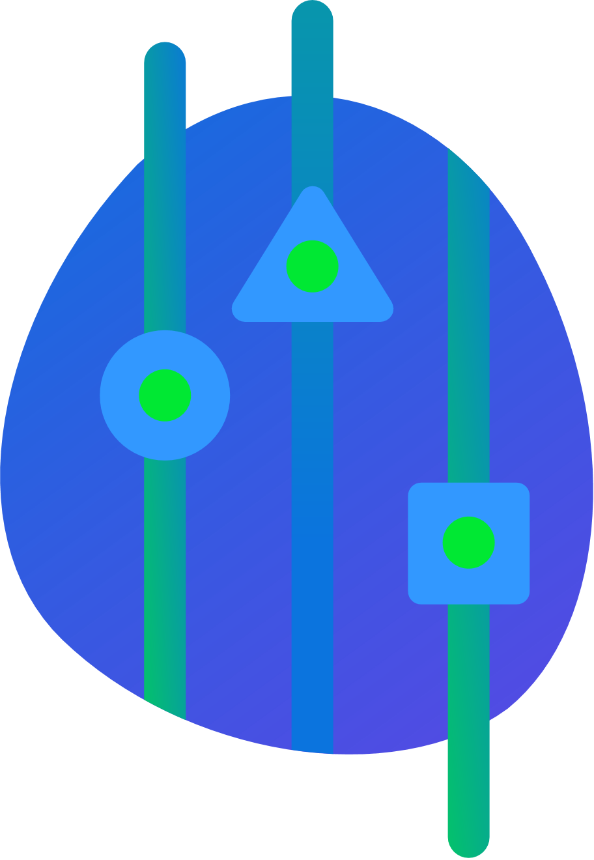
Kyma features
Application Connector
Serverless
Service Management
Notes:
And this slide is strongly connected to benefits slide. With Benefits slide you just bring in a blurry but enough for start one-sentence benefit.
You jump into this slide and explain in more details how it is possible, to connect different services, how connect seamlessly and also use any technology.

Slide 7




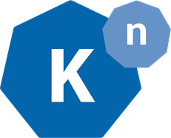





Kyma architecture
Micro API Gateway
Any Business Solution, cloud and/or on-prem
Enterprise app API calls
Observability
Any Open Service Broker (OSB) compatible service provider
Mashups
Events
Events routing
Functions
Application Connector
Service Catalog
Microservices
Kyma API calls
Service Management
Notes:
This slide is a connection to slide about benefits and features. So you say what is the benefit of using Kyma, you explain it is possible thanks to out key components and then jump into this slide to explain kyma architecture. So from one sentence slogan you slowly jump into details, step by step
Because of complexity of Kyma there is no easier way to present Kyma architecture than with this diagram. The purpose of this diagram is to show all most important parts, with icons that relate to project we integrate so audience can quickly identify themselves with icons they know so they can easier understand.
Steps to start a story:
1. Introduce left side as an application that can be integrated into Kyma and expose all functionalities inside through Application connector
2. Introduce right side, to explain that in Kyma you can also consume all other services, like managed services from cloud providers directly inside Kyma
3. Introduce bottom side that its vision is to run on managed k8s clusters
4. Introduce middle side:
- explain that extensibility is possible thanks to enablement of events communication and easy consumption through microservices and functions
- explain that through gateway functionality everything can be exposed to outside
- explain that all imporntat observability points like monitoring and tracing is embedded

Slide 8
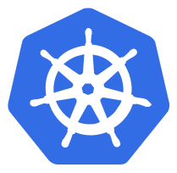





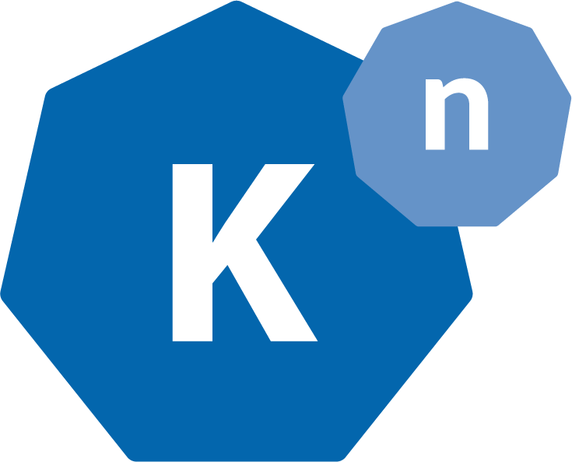

Kyma glue - cause reinventing the wheel sucks
Istio
Grafana
Jaeger
Kubernetes
OpenAPI
AsyncAPI
Loki
Prometheus
Open Service Broker
Dex
NATS
Knative
Minio
Notes:
We want to point out also the big advantage of Kyma that it is not trying to reinvent things. Kyma is gluing all best clound native tools. Going through integration hell that you do not want to go through on your own.
First of all we use Kubernetes as much as possible, like Custom Resources or Service Catalog
We realize security through Dex
We follow standards through integration with commonly known specifications like the ones in the picture
Whole observability and logging stack is based on known and respected projects like the one in the picture
Media files storage is based on Minio
Service Mesh is realized thanks to Istio
And last but not lease eventing is based on Knative and NATS
Everything as you see, as lightweight as possible to decrease cluster costs to minimum

Slide 9
There is more…
Notes:
3 main features metioned before are just key feature, but we have much more

Slide 10
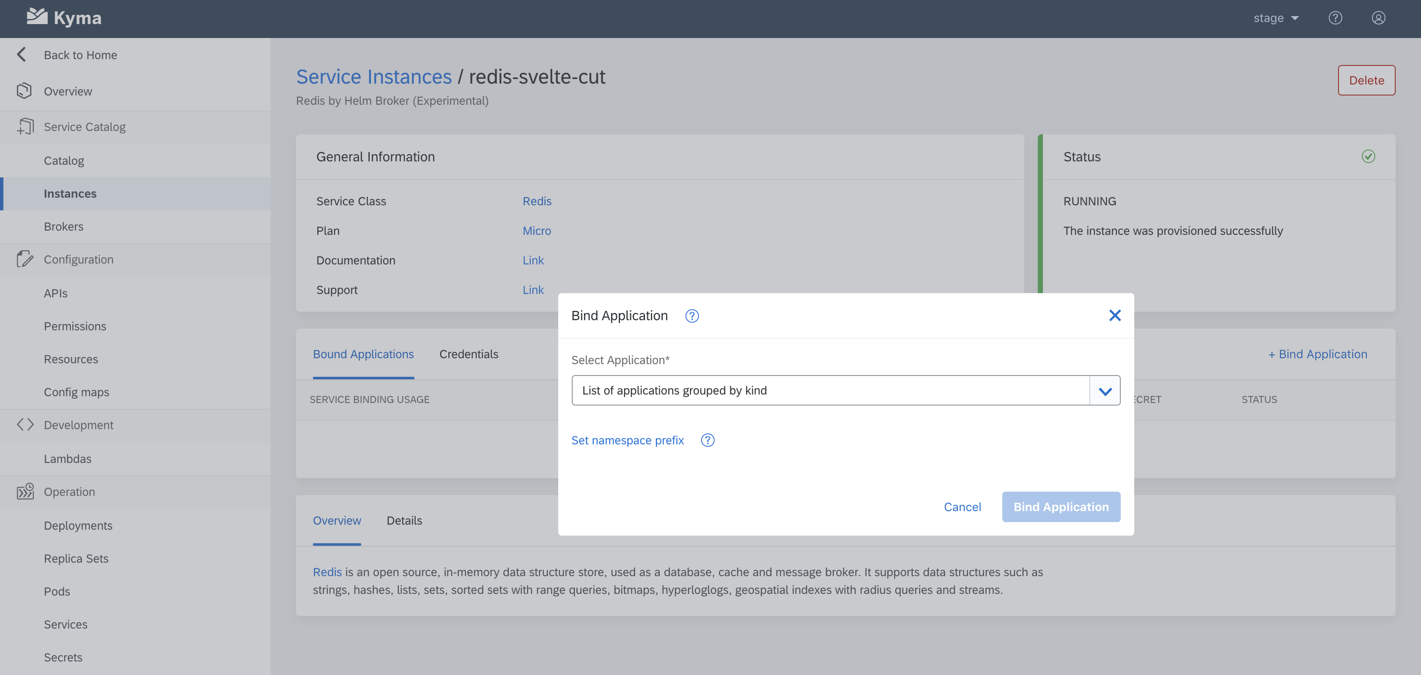
Console UI with functionality 1:1 available in CLI
Notes:
First of all advertise we have custom UI for our Kubernetes resources and also other Kubernetes native resources.
Then basing on attached screen shot make it clear that UI functionality is always functional through CLI because one of our main principles is „CLI First”

Slide 11
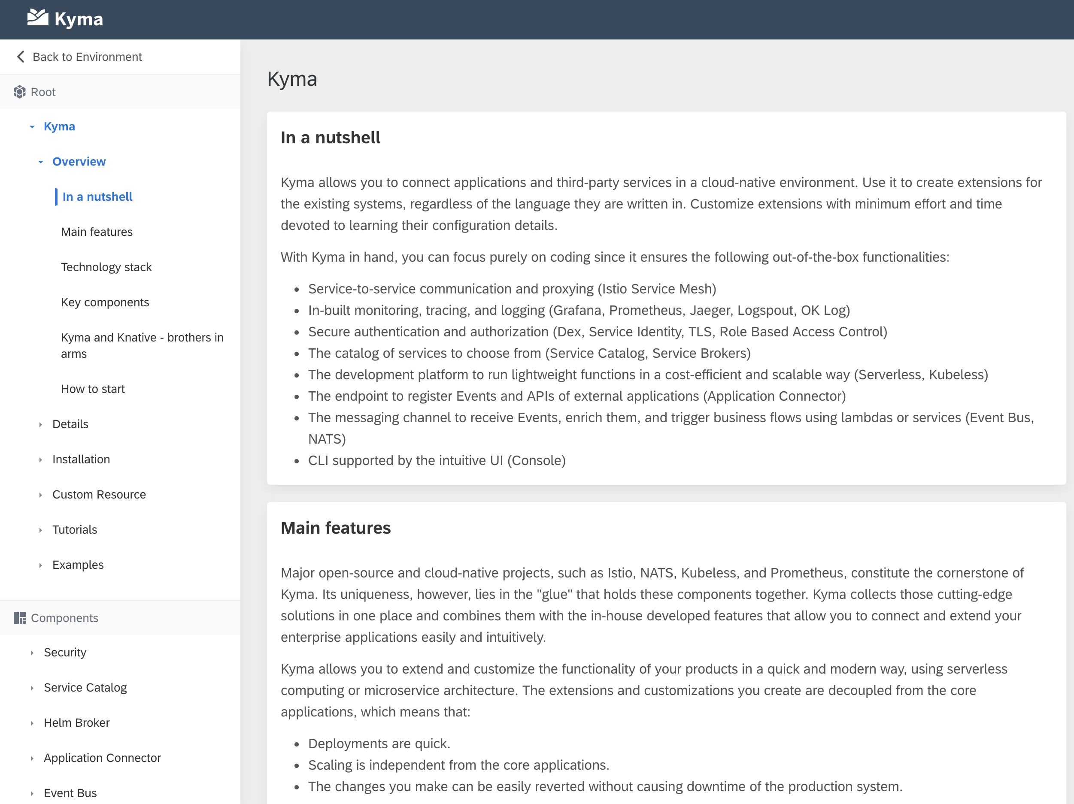
Baked-in docs
Notes:
Explain that once you get a Kyma cluster, it has all you need including documentation. The most important is that it is part of console UI and it is always with docs for a given Kyma version that was used to set up the cluster

Slide 12
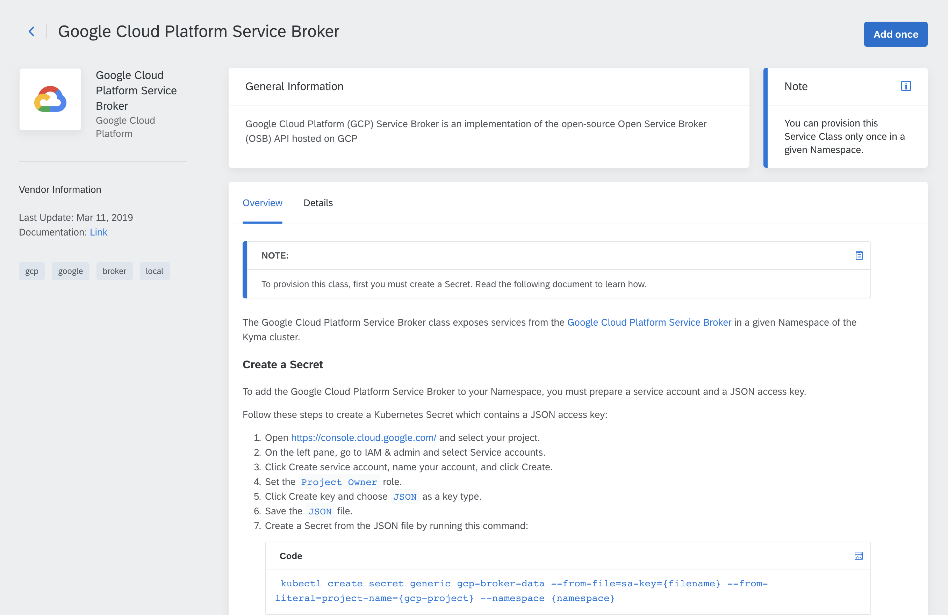
Contextual docs
Notes:
Whenever possible we have contextual documentation, like in case of service catalog, every Service Class and its instance can be enriched with additional documentation.
And it is not only markdown. Documentation. In case of APIs, if provided, we suport rendering of OpenAPI, OData and AsyncAPI

Slide 13
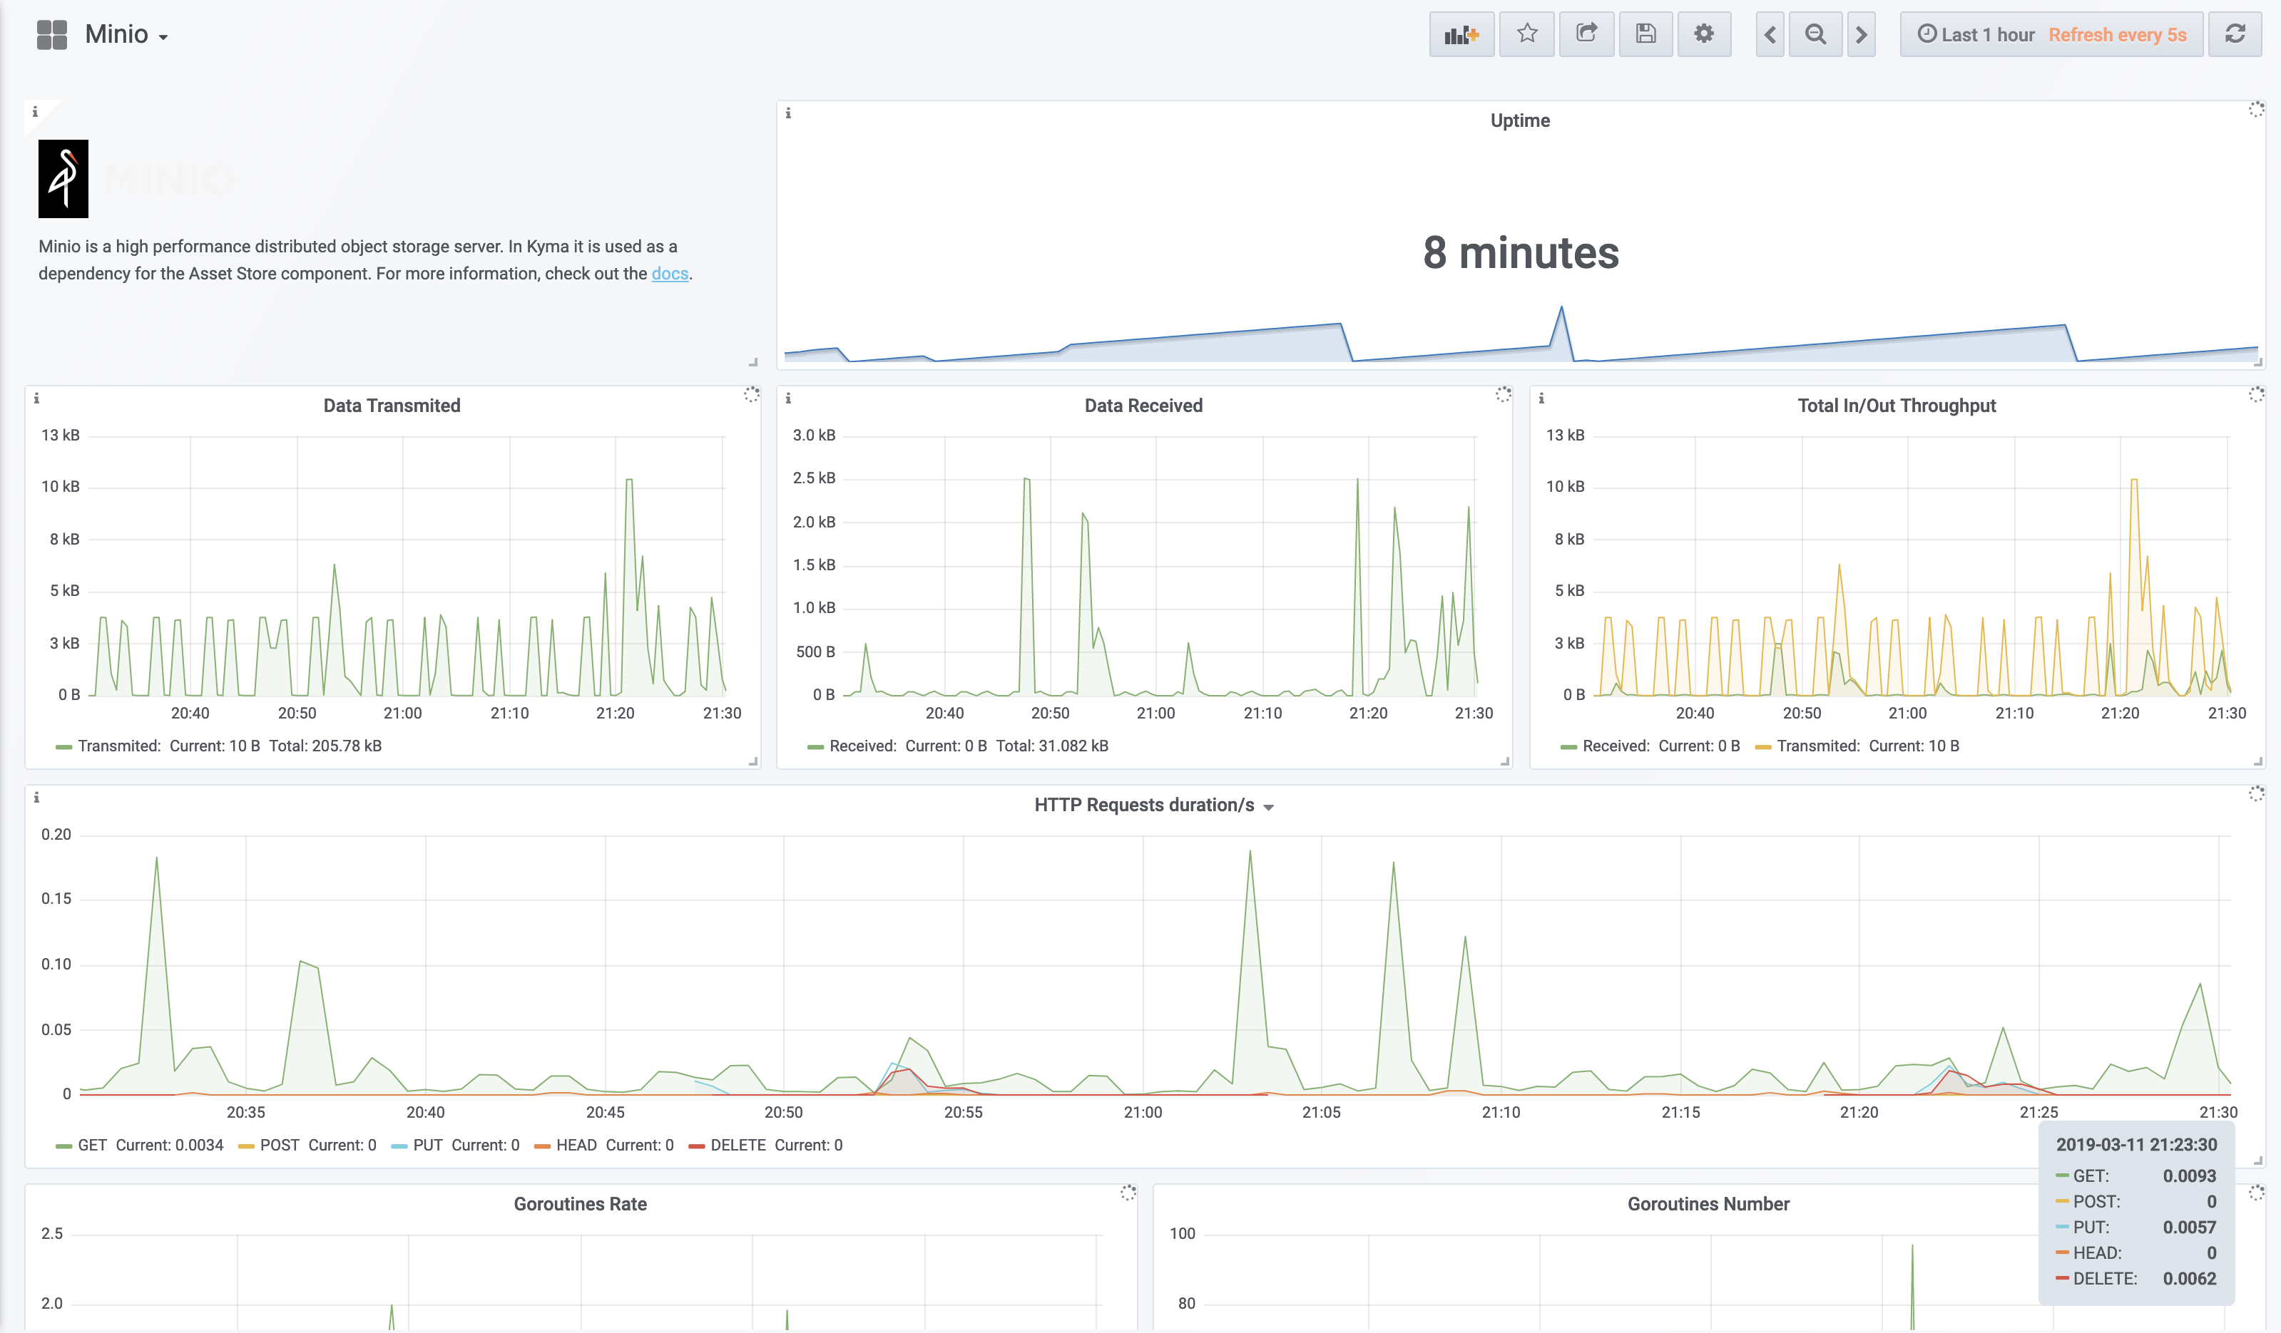
Monitoring integration
Notes:
Kyma comes with integration of Prometheus and Grafana. We have a set of predefined dashboards for our components, and out of the box custom dashboards for lambdas/functions

Slide 14
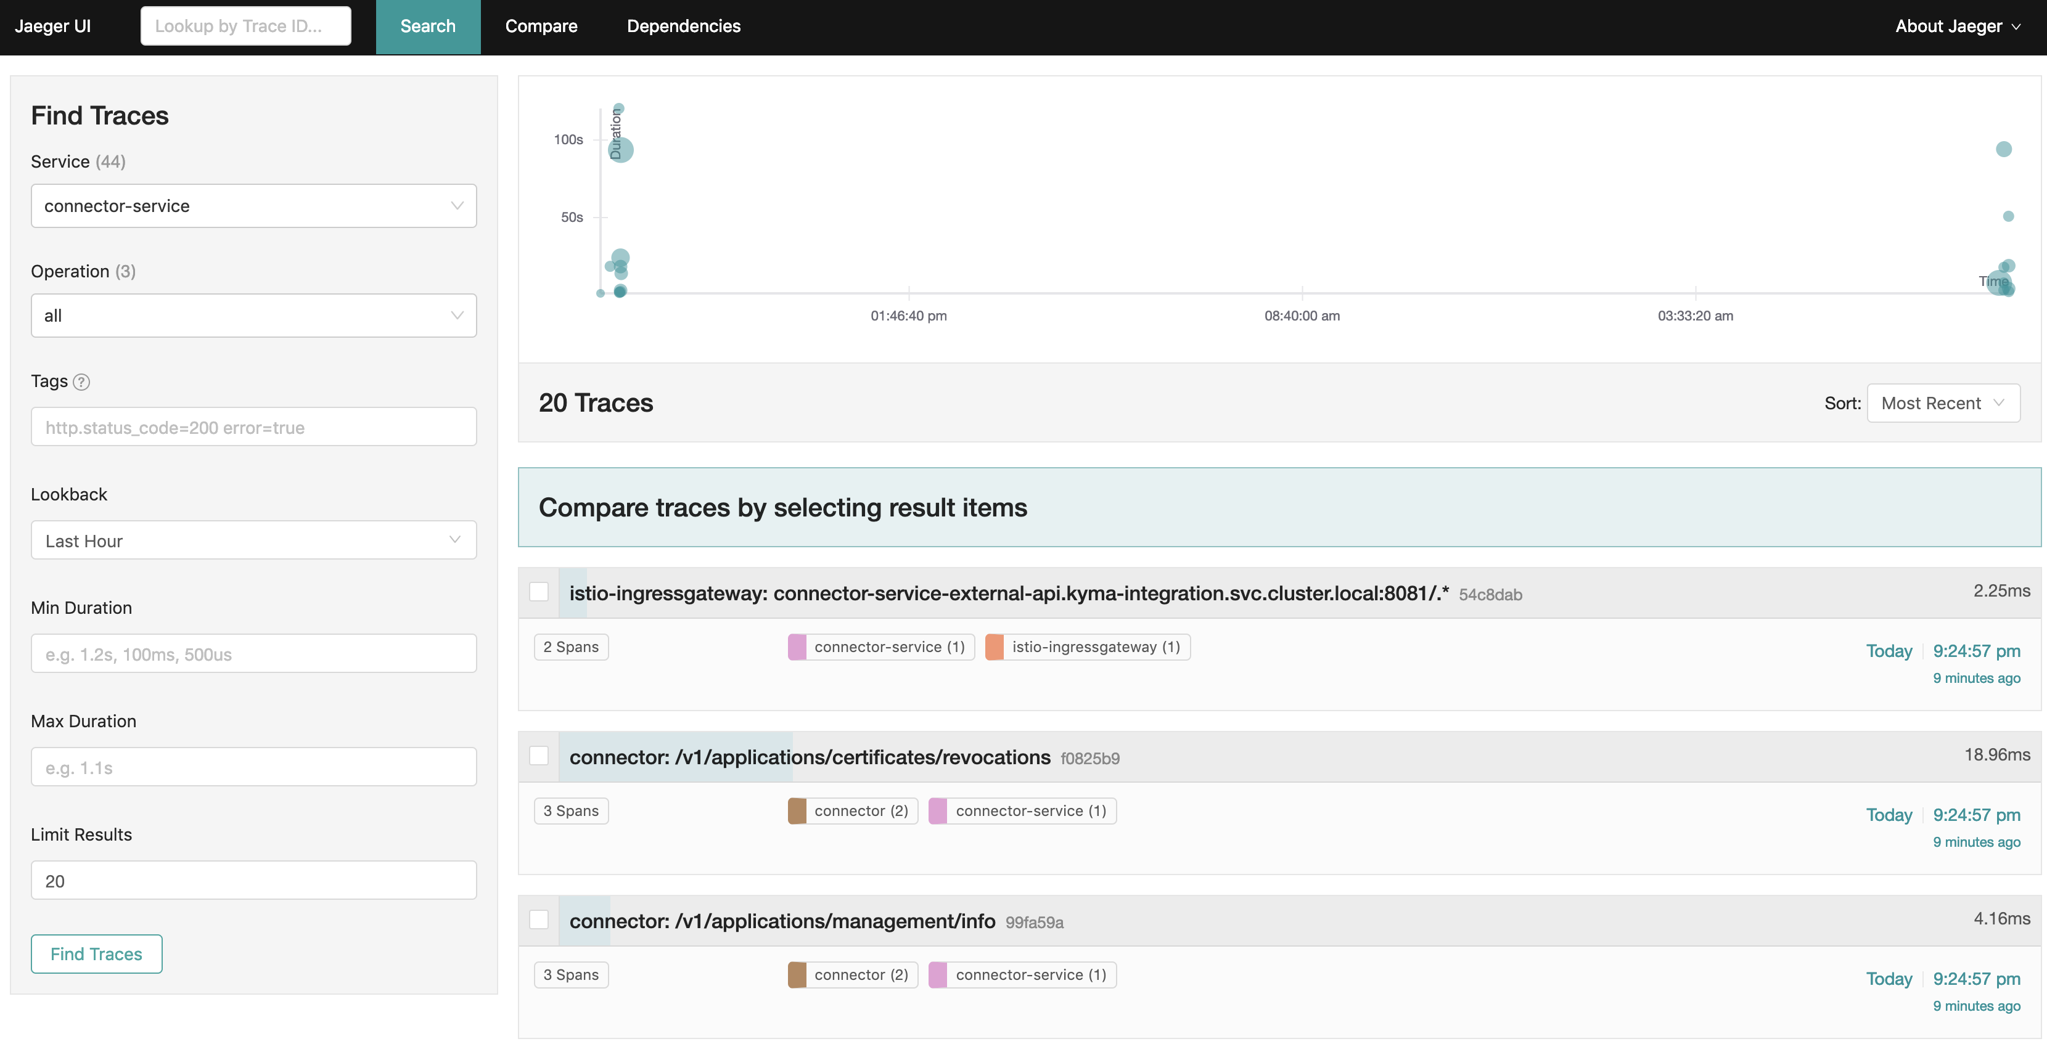
Tracing integration
Notes:
Except of Prometheus and Grafana we also have integration with jaeger for tracing requests

Slide 15
Other benefits/features
Local development with Kyma lite on Minikube
Event bus with Knative
Micro API Gateway with Istio
UI extensibility with microfrontend approach with Luigi
Assets store with Minio
Helm broker for easy exposure of helm charts in Service Catalog
Notes:
It is important to mention that Kyma can be used on local on minikube for development and it is efficient thanks to Kyma lite version without components that usually are not important for local development, like monitoring and tracing. Of course there is option to install them on local if needed
Mention that we have custom event bus based on Knative internally that handles events delivery from external system to services and functions in Kyma
Point out that with support of Istio we build minimalistic API Gateway for convenient way of exposing services to the outside world
The Console UI is extendible, you can add your own views that to the integration with Luigi open source that makes it possible to integrate microfrontends in the UI
We also have a component that introduces multi-cloud support for storing assets, where on local you store files in minio while on cluster you can switch to minio gateway mode and use GCS or Azure Blob for storing various files
Helm broker integrates with Service Catalog and through proper configuration of different bundles repositories you can enrich Kyma Service Catalog with different services through the helm charts

Slide 16
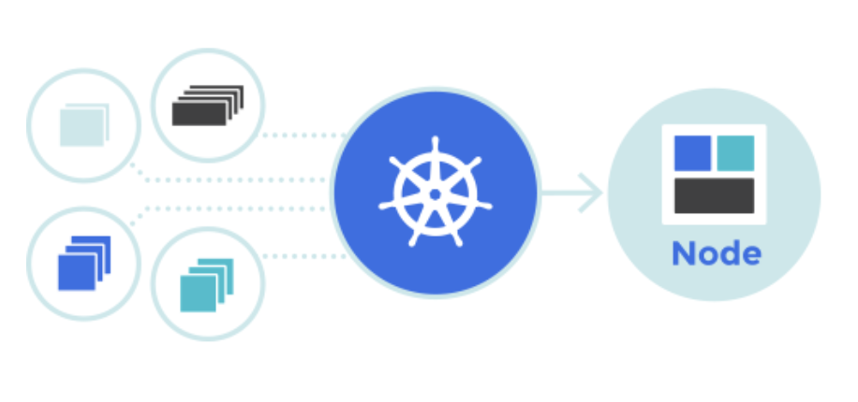
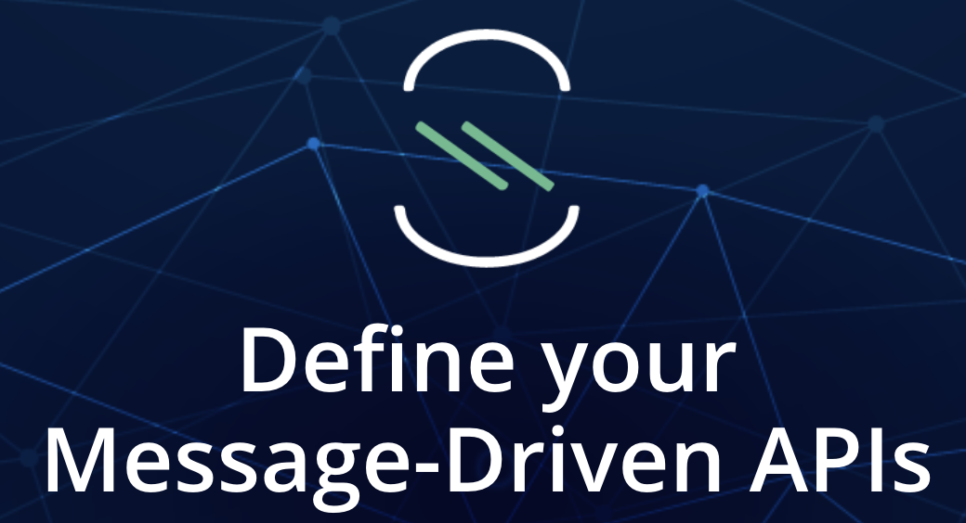
Kyma donation initiatives
Knative joined development
AsyncAPI involvement
Service Catalog SIG members
Notes:
Make strong statement that Kyma is not only consumer of open source it also pays back if possible to peer-communities. This is needed not only point out we contribute, we should also point out those communities, advertise them.
- We donated to Knative eventing the NATS channel
- We donated to AsyncAPI specification the spec rendering component written in react and it will soon become official spec editor
- We contribute constantly to Kubernetes Service Catalog, huge contribution was rewrite of solution to support custom resource definitions

Slide 17

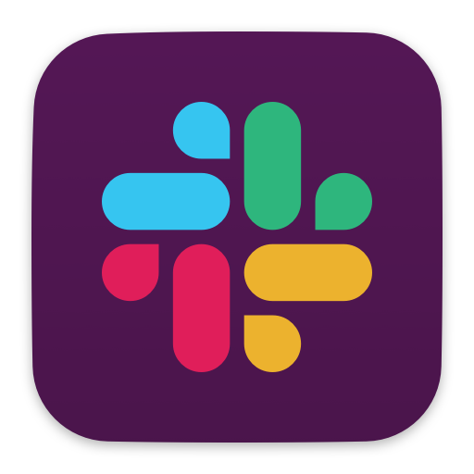
Become a Contributor
Request a feature or report a bug - https://github.com/kyma-project/kyma/
Join the SIG CORE - https://github.com/kyma-project/community/tree/master/sig-and-wg/sig-core
Contact the Kyma team directly on Slack - slack.kyma-project.io​
Notes:
Make is clear we are open for contributions:
- not only code contribution is welcome, for starter create issues and feature requests
- remind we have online public meeting so it is easy to connect with other contributors and engage with experts
- show we also have public slack workspace where people can go and exchange ideas, ask questions, receive hints and tips, and extend your experience on Kyma

Slide 18

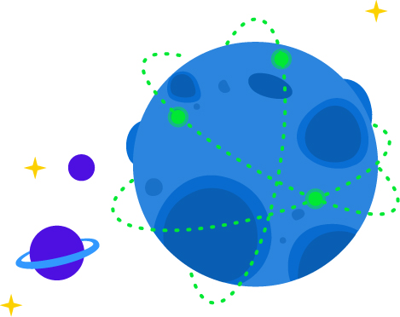


Learn more on https://kyma-project.io
@kymaproject
linkedin.kyma-project.io
youtube.kyma-project.io
YouTube
slack.kyma-project.io
github.com/kyma-project
Notes:
Summary of all the channels where community can engage with Kyma

Slide 19
Thank you
Contact information:
Name Title Address Phone number
Notes:
Put your details here

